Slide 1
Stroke Detection
Chaitanya Padamata, Karthik Chellamuthu, Michael Dang

Slide 2
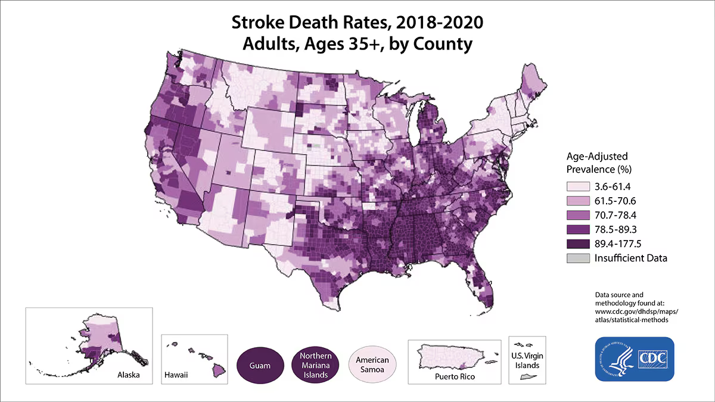
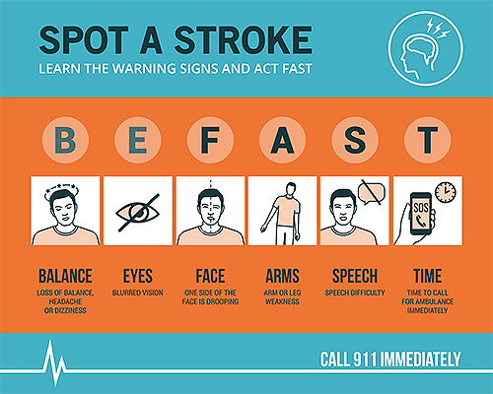
Summarize
Motivation: Early action is crucial in stroke cases, as the chances of survival significantly increase with immediate emergency treatment.
Problem Statement: Stroke is a medical emergency where delayed treatment can lead to severe disability or death. Many victims do not receive timely treatment due to delays in recognizing symptoms and accessing emergency care.
Proposal: The recent advancements in AI and machine learning present an opportunity to develop a platform that can detect potential strokes early.

Slide 3
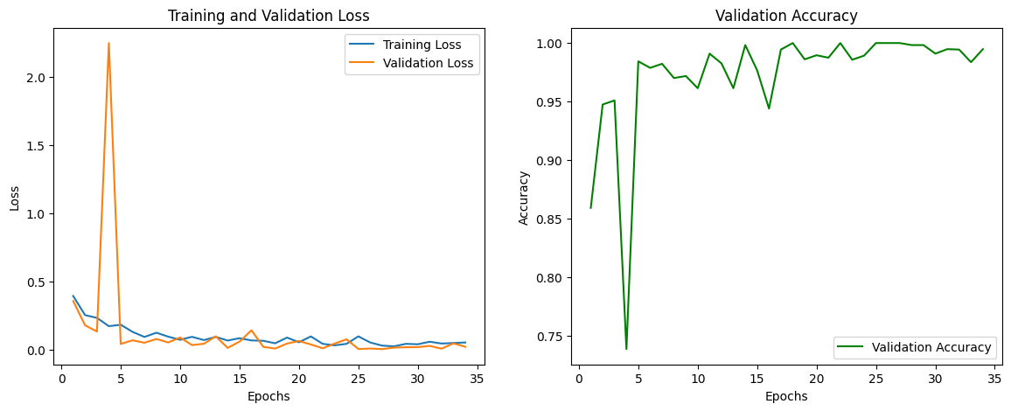
Residual Network
ResNet50 for facial stroke prediction with 98.37% of accuracy over 3770 images consists of two classes: stroke and no stroke where data augmented techniques were used.
Model performance:

Slide 4
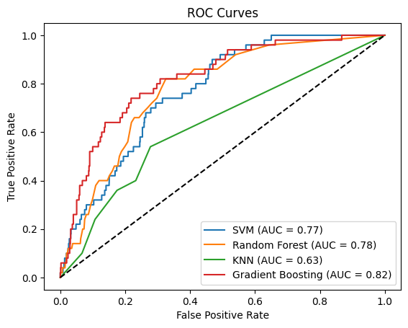
Random Forest
For stroke prediction based on medical history data, the Gradient Boosting model achieved an accuracy of 81.95%, outperforming other models such as K-Nearest Neighbors (KNN), Support Vector Machine (SVM), and Random Forest.
The dataset used for training was imbalanced, with more non-stroke cases than stroke cases; hence, SMOTE was applied.
Model performance:

Slide 5
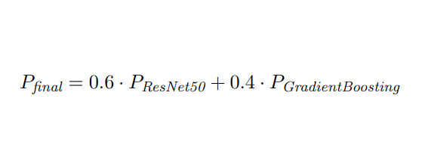
Multimodal
To enhance the performance of your stroke prediction system, you're combining the predictions from two models: ResNet50 (trained on facial images) and Gradient Boosting (trained on medical history).
The combined multimodal approach assigns a 60% weight to the ResNet50 predictions and 40% to the Gradient Boosting predictions, reflecting the importance of both image-based and medical data in stroke detection.

Slide 6
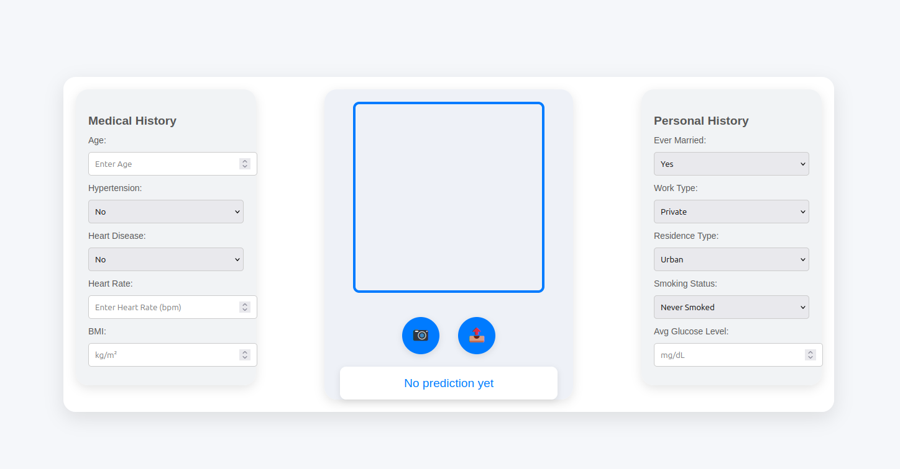
User Interface

Slide 7
Overview
Frontend (home.hbs)
Model pretrain (face_stroke.ipynb, medical_history.ipynb)
Backend (index.js, mongo.js)
Deployment (app.py)
Model pretrain (face_stroke.pth, medical_history.pth)
Database (MongoDB)

Slide 8
Challenges
Trouble connecting multimodal with frontend (data format mismatch, API communication)
The UI camera doesn’t work
Limited to LLM integration

Slide 9
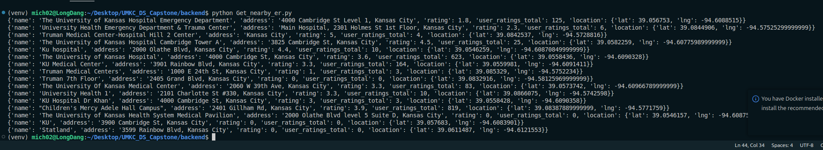
Future work
Fix the data format and ensure API is working well
Improve UI with camera available
Incorporate LLM into the platform
Set an emergency switch when the predict above 95% chances of having stroke.

Slide 10
Thank you

